Slide 1
Blockchain Balloting
Jarrett Alexander
Luke Seidl

Slide 2


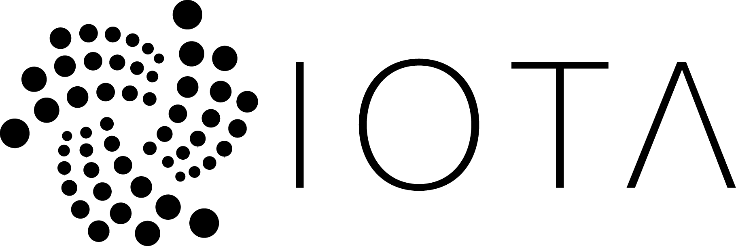
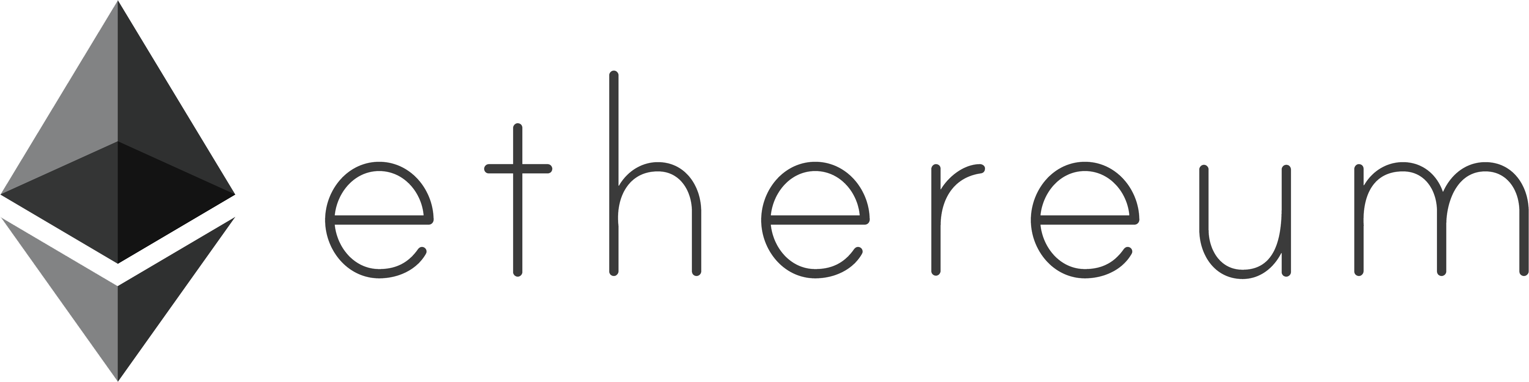
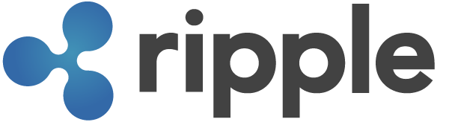
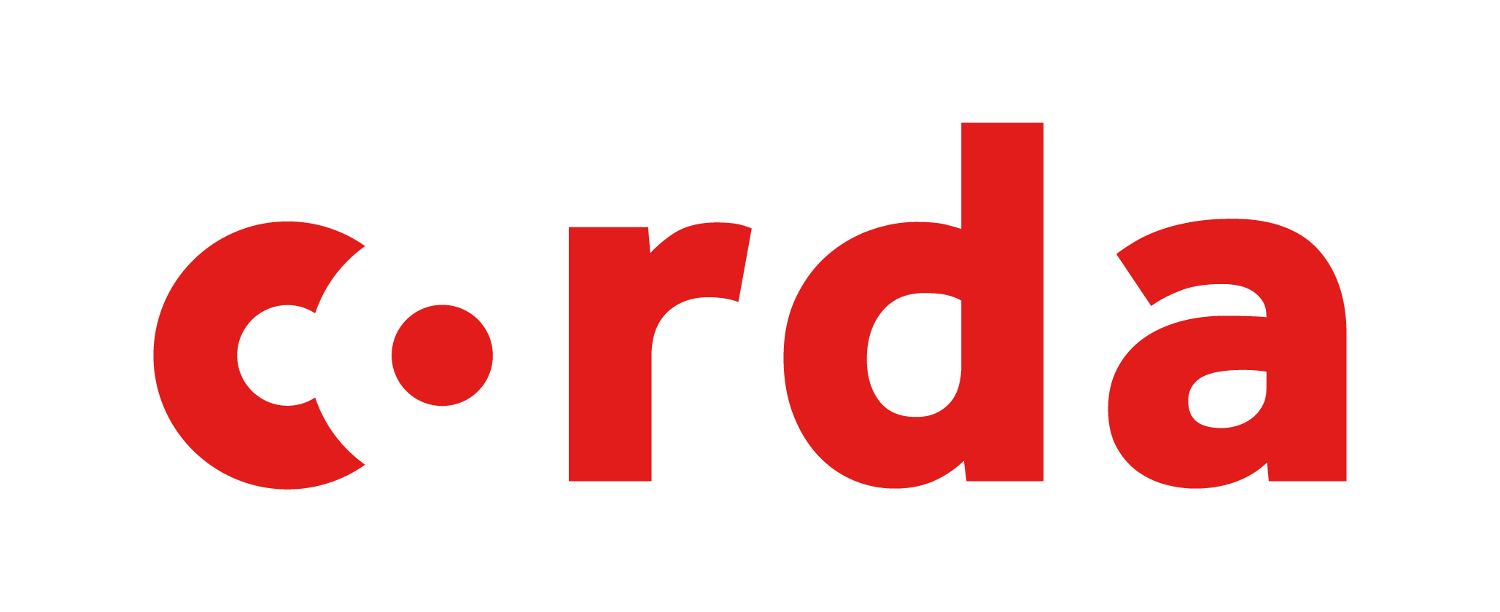


Why Blockchain?
aws

Slide 3
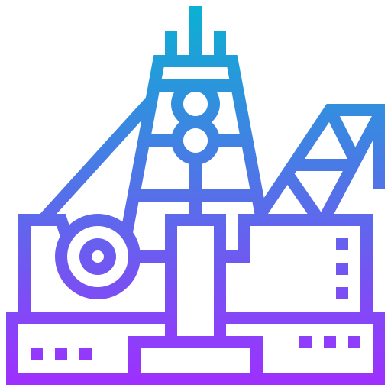
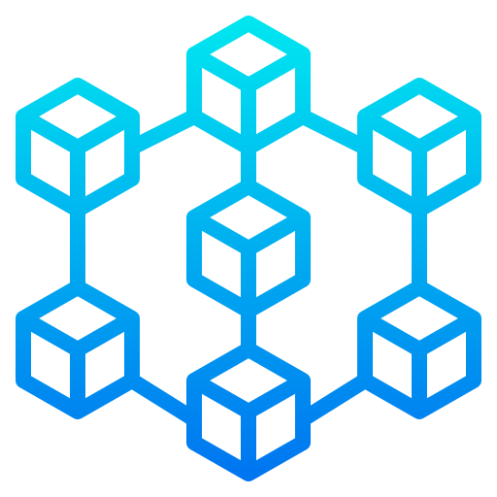
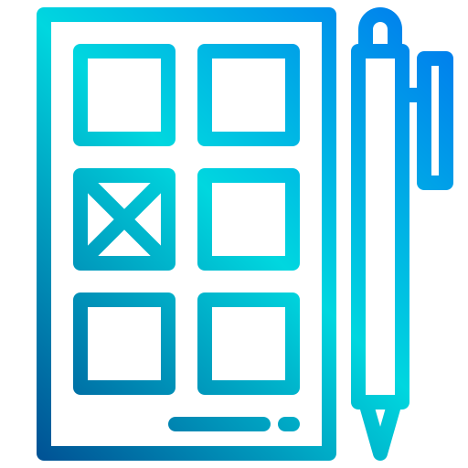
What problem are we trying to solve?
Company A
Company B
https://www.flaticon.com/authors/srip
https://www.flaticon.com/authors/eucalyp
https://www.flaticon.com/authors/xnimrodx

Slide 4
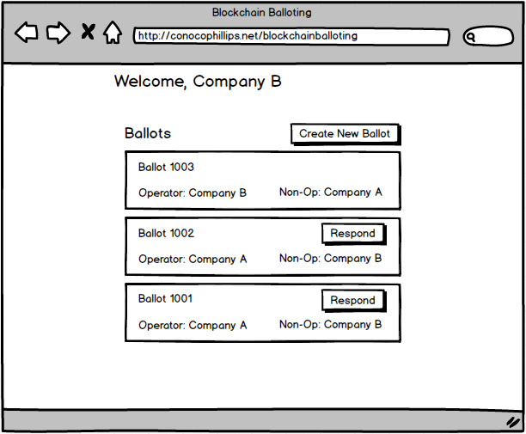
What will you be building?
Blockchain application that allows creating and responding to ballots
Web frontend to interact with your blockchain app
Ballot 1001
Operator: Company A
Non-Op: Company B
Response to 1001
Responder: Company B
Response: Yes

Slide 5

What skills will you use?
Blockchain application development
Java/Kotlin
HTML/Javascript
Communication skills
https://media.giphy.com/media/o0vwzuFwCGAFO/source.gif

Slide 6

Questions?

